Slide 1

Decoding Dependency Management
Simplifying and Securing Package Management
Samarth Agarwal
DevOps CoE
Notes:
Hello everyone, my name is Samarth Agarwal and today I am going to talk about dependency management and few problems associated with it and what are some solutions around it

Slide 2
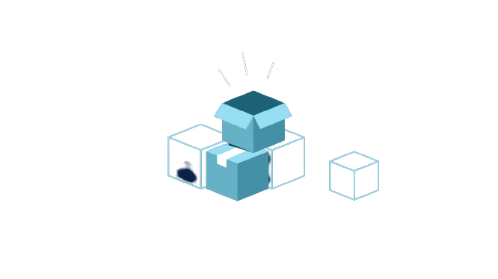
Decoding Dependency Management
Simplifying and Securing Package Management
How?
What?
Why?
What is package management ?
Current Challenges and Security Concerns and its Business Impact
Our Solution to the problem
Demo
DevOps CoE
Notes:
I have divided this into 3 sections ..
What is dependency management ?
Why are we discussing it ? talking about current challenges and concerns
And How are we going to solve this ?

Slide 3
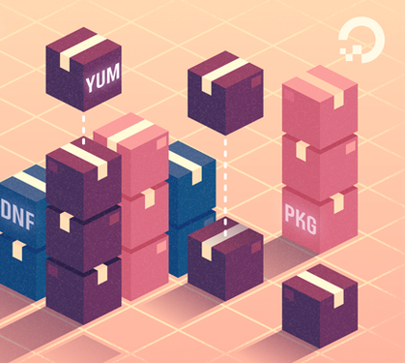
Decoding Dependency Management
Simplifying and Securing Package Management
What is Dependency Management ?
Dependencies are external packages which are required for compiling project code
Restoring dependencies is very basic and primitive part of project code build
Helps in bringing reusability, faster development and smaller artifact sizes
DevOps CoE
Notes:
SLIDE
Pretty basic right, we all use this in our projects. We all at some point rely on 3rd party packages, which is basically a pre build efficient pieces of code whose functionality we wish to use in our projects. So now let’s talk about some of the problem areas around it

Slide 4




Decoding Dependency Management
Simplifying and Securing Package Management
Current Problems and Challenges
Governance and Control
Usage Visibility
Less governance and control issues due to no consolidated view of information related to dependencies used
Too many dependencies can lead to bad usage patterns and can often lead to accumulation of unused packages lying in the project
Package Vulnerabilities
I don’t Know My Dependencies
Dependencies can have serious security flaws endangering the system
Less visibility or knowledge of used packages in terms of package versions and license can lead to security issues and other problems
Package High jacking and Substitution attacks
Reporting and Automation
No automated analysis, scanning and reporting of problems mentioned herewith
Getting the compromised package from the repository
Notes:
Governance and control
When it comes to large projects with multiple teams and multiple sub projects, it can become difficult in managing and owning dependencies due to lack of centralization and no single view of governance and control.
Package Vulnerabilities
Even most commonly used packages can be of serious damage to your product if it has severe security vulnerabilities. Most recent example can be of Log4J which led to wide spread disruption in the whole industry.. Even the rovers on Mars were affected.
Package highjacking and substitution attacks
A package may get compromised at source or during the transit or some malicious code is inserted . This can lead to major security threat
Usage Visibility
Sometimes due to a large project scale, the dependencies used are often ignored and we tend to carry on unused dependencies in our releases leading to unnecessary code. It could also be possible that the dependencies being used are set to auto upgrade so that when a new version is available it is downloaded and used in the project automatically.. This can also introduce problems if the newer version is not compatible with our code.
I don’t know my dependencies
Many a times we want to know whether the packages that we carry are license compliant or not or did we use an older version of package which was vulnerable . So, we lack a centralized view of knowing more about the packages being used
Reporting and Automation
We tend to lack an automated mechanism to analyse the project ecosystem against these problems and generating reports out of it for our awareness.
Taking these problems and challenges as a key area we have devised a solution around it. So the question is how does it helps us in solving problems in this area. Let’s have a look

Slide 5
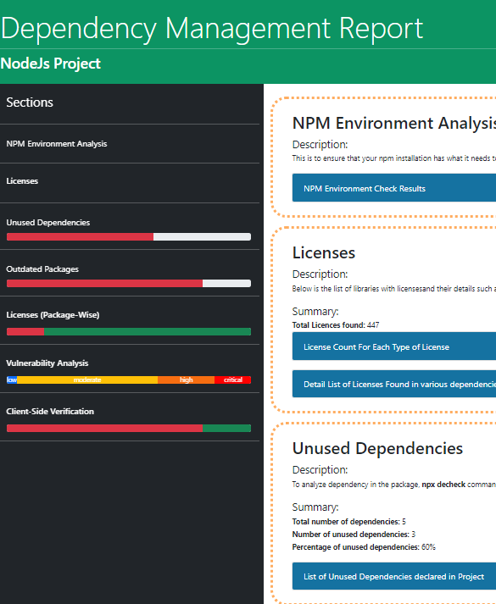
Our Solution to the Problem
Dependency Analyzer –
A custom-made tool for Analyzing Usage, Finding Security Vulnerabilities and along with a Reporting capability of dependencies used in the project
A Package Linter that does more than a Linter is supposed to do
Solution available for
Maven
NPM
Nuget
Integrated with Jenkins and Azure DevOps
DevOps CoE
Notes:
..Its a scripting-based tool and reports are generated in HTML
We have linters for code..This tool acts like a package linter that does more than a linter is supposed to do..
Let’s see how these problems are solved using this tool.

Slide 6


Decoding Dependency Management
Simplifying and Securing Package Management
Features of Solution
Governance and Control
Reporting
Analyzing Dependencies used in the project and their usage patterns
Generates an HTML Report of the analysis and suggestions
Usage Analysis
Customizable and Extensible
Reporting unsafe version declarations
Package License Reports
Reporting unused packages
Reporting, analysis and Integrations with CI/CD systems can be tailor made based on specific requirement or a generalized solution can be used
Integration with CI/CD
Integration Capabilities with CI/CD Tools for automated execution. (It has been integrated with CI Workflow accelerator of DevOps CoE). Option to fail a build if the project doesn’t comply with the standard
Package Vulnerabilities
Reporting Security Vulnerabilities* present in the package along with severity of the issues
Notes:
Governance and control
Goes through the config files and analyses the usage patterns and point out the wrongly used dependencies..
Usage analysis
Unsafe version can be alpha beta or those versions of dependencies which may be deprecated and outdated
License report – what is the license that the dependency is carrying and its capability with allowed licenses
Unused packages
Reporting features – HTML, CSS, JS
Generating attractive and easy to read HTML reports
Integration with CI/CD for automation
Generating easy to read HTML reports which can be embedded in the CI tools for a consolidated view
Package Vulnerabilities
It uses either out of the box utilities of package manager or 3rd party tools. //can also be integrated with the tool for example dependency check..
Customizable and extensible
Same

Slide 7

Demo
Decoding Dependency Management
DevOps CoE
Notes:
Now we will move onto a quick demonstration of all the Three Utilities that we have developed under this solution

Slide 8
Happy DevOps
Thank You
DevOps COE
Notes:
Thank You for Listening
Now you can ask any queries or share suggestions that you have regarding dependency management.

